Slide 1
The What, Why and How of Client-Side MVC Frameworks
or…what I should have called it
The What, Why and How of Javascript MV*-ish (kinda-sorta…whatever) Frameworks

Slide 2
Ummm…What?
There are a class of Javascript frameworks that are said to be MV* in pattern. We are going to discuss these.

Slide 3
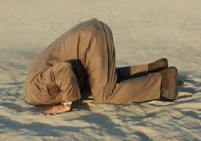
The Lifecycle of the Modern Web Developer re: Javascript
Stage 1: Denial

Slide 4

The Lifecycle of the Modern Web Developer re: Javascript
Stage 2: jQuery

Slide 5

The Lifecycle of the Modern Web Developer re: Javascript
Stage 3: Realization that Javascript is Cool

Slide 6
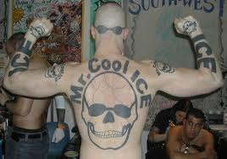
The Lifecycle of the Modern Web Developer re: Javascript
Stage 3: Realization that Javascript is Cool

Slide 7

The Lifecycle of the Modern Web Developer re: Javascript
Stage 3: Realization that Javascript is Cool

Slide 8

What Is Your Quest?

Slide 9
I Do Not Have All The Answers For You
I’m just here to give you the big picture.

Slide 10
Let’s start by hearing from them in their own words

Slide 11
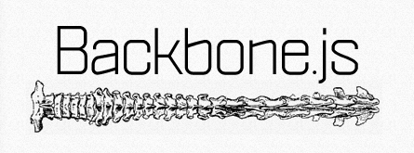
Backbone supplies structure to JavaScript-heavy applications by providing models with key-value binding and custom events, collections with a rich API of enumerable functions, views with declarative event handling, and connects it all to your existing application over a RESTful JSON interface.

Slide 12
Spine
No cool logo
Spine is a lightweight framework for building JavaScript web applications. Spine gives you a MVC structure and then gets out of your way, allowing you to concentrate on the fun stuff, building awesome web applications.

Slide 13

A JavaScript framework for writing powerful web applications with less code.
SproutCore applications move business logic to the browser so they can respond to your users' taps and clicks immediately, avoiding an agonizing roundtrip across often intermittent network connections.

Slide 14

A collection of the best practices and tools for building JavaScript applications. Built on top of jQuery, it consists of the following standalone components: StealJS (dependency management), FuncUnit (testing), jQueryMX (jQuery plugins for MVC) and DocumentJS (documentation)

Slide 15

Simplify dynamic JavaScript UIs by applying the Model-View-View Model (MVVM)

Slide 16
If nothing else, the frameworks give you a metaphor to work under

Slide 17
Perhaps a code sample will help

